Slide 1
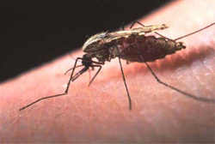
Updated Management of Dengue Fever and DHF
Prof. Quazi Tarikul Islam FCPS, FACP, FRCP(Edin. Glasg.) Professor of Medicine
Popular Medical College Hospital

Slide 2
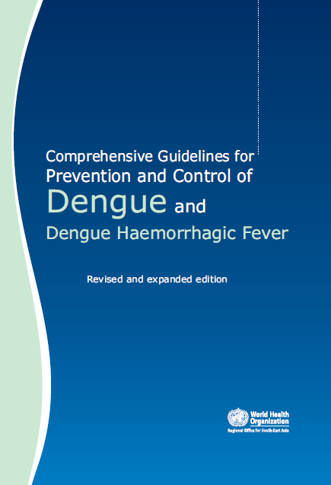

Slide 3
Dengue virus infection
10,000
Asymptomatic Symptomatic
Viral syndrome Dengue fever DHF
9,000
1,000
500
400
100
Plasma leakage
Expanded dengue syndrome (Uncommon)
Prolonged shock: liver failure,
renal failure,…Encephalopathy…
Co-morbidities
3. Co-infections
4. True dengue infection - encephalitis
DHF
DSS
1-2

Slide 4
Primary triage
Triage has to be performed by a trained and competent person.
If the patient arrives in hospital in a severe/critical condition, then send this patient directly to a trained nurse/medical assistant.
For other patients, proceed as following:

Slide 5
Primary triage
History of the duration of fever and warning signs of high-risk patients to be assessed by a trained nurse or staff, not necessarily medical.
Tourniquet test to be conducted by trained personnel
If there is not enough staff, just inflate the pressure to 80 mmHg for >12 years of age and 60 mmHg for children aged 5 to 12 years for five minutes).
Vital signs, including temperature, blood pressure, pulse rate, respiratory rate and peripheral perfusion, to be checked by trained nurse or medical assistant.

Slide 6
Tourniquets test and capillary refill time(CRT)
CRT:
Pressing the nail of the thumb of left hand in rt handed person or vice versa till blancing and then release suddenly. The time taken for flushing is the CRT

Slide 7
Primary triage
Peripheral perfusion is assessed by palpation of pulse volume, temperature and colour of extremities, and capillary refill time.
Particular attention is to be given to those patients who are afebrile and have tachycardia.
These patients and those with reduced peripheral perfusion should be referred for immediate medical attention, CBC, Liver Enzymes and Dengue NS1 and serology at the earliest possible.

Slide 8
Primary triage
Recommendations for CBC:
All febrile patients at the first visit to get the baseline HCT, WBC and PLT.
All patients with warning signs.
All patients with fever >3 days.
All patients with circulatory disturbance/shock (these patients should undergo a glucose check).
Results of CBC: If leucopenia and/or thrombocytopenia is present, those with warning signs should be sent for immediate medical consultation.

Slide 9
Primary triage
Medical consultation: Immediate medical consultation is recommended for the following:
shock.
patients with warning signs, especially those whose illness lasts for >4 days.

Slide 10
Primary triage
Decision for observation and treatment:
Shock: Resuscitation and admission.
Those with warning signs.
High-risk patients with leucopenia and thrombocytopenia.

Slide 11
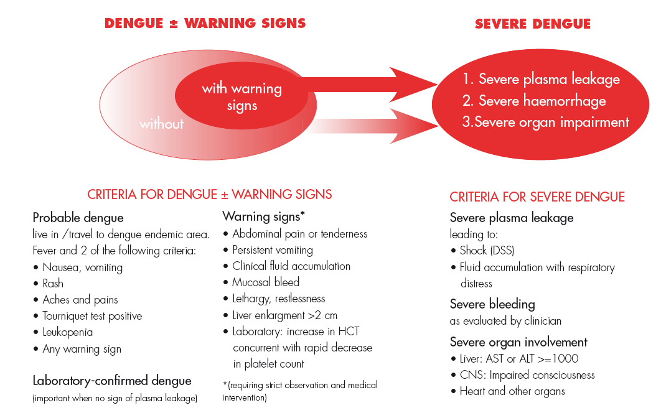

Slide 12
Primary triage
Patient and family advice should be carefully delivered before sending him/her home.
This can be done in a group of 5 to 20 patients by a trained person who may not be a nurse/doctor.
Advice should include bed rest, intake of oral fluids or a soft diet, and reduction of fever by tepid sponging in addition to paracetamol.
Warning signs should be emphasized, and it should be made clear that should these occur patients must seek immediate medical attention even if they have a scheduled appointment pending.

Slide 13
Home care advice (family education) for patients:
Patient needs to take adequate bed rest.
Adequate intake of fluids (not only plain water) such as milk, fruit juice, isotonic electrolyte solution, oral rehydration solution (ORS) and barley/rice water.
Beware of overhydration in infants and young children.
Keep body temperature below 39 °C.
If the temperature goes beyond 39 °C, give the patient paracetamol.

Slide 14
Home care advice (family education) for patients:
Paracetamol should be administered in frequencies of not less than six hours.
The maximum dose for adults is 4 gm/day. Avoid using too much paracetamol, and aspirin or NSAID is not recommended.
Tepid sponging of forehead, armpits and extremities. A lukewarm shower or bath is recommended for adults.

Slide 15
Primary triage
Follow-up visits:
Patients should be aware that the critical period is during the afebrile phase and that follow-up with CBC is essential to detect early danger signs such as leucopenia, thrombocytopenia, and/or haematocrit rise.
Daily follow-up is recommended for all patients except those who have resumed normal activities or are normal when the temperature subsides.

Slide 16
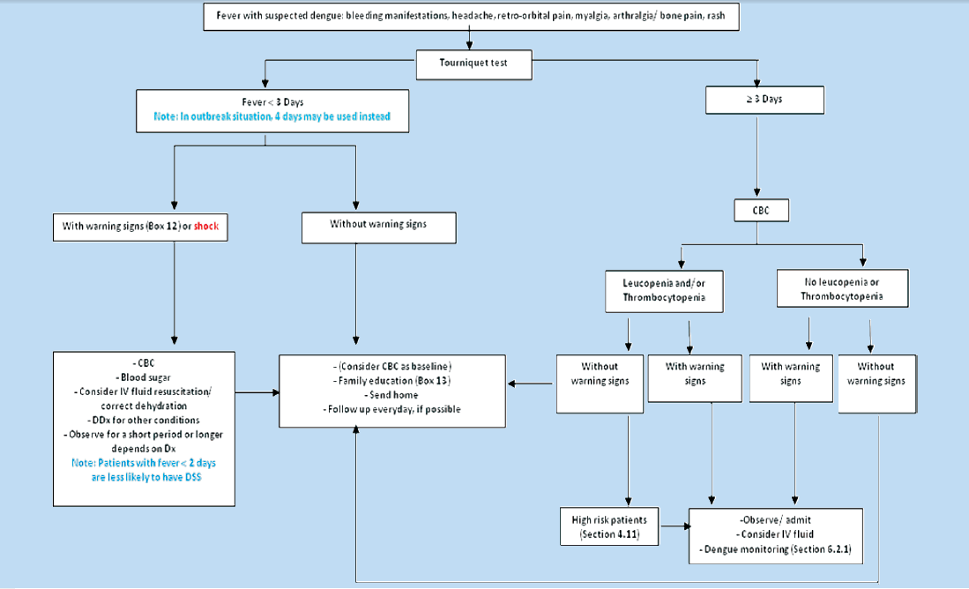
Primary triage

Slide 17
Primary triage

Slide 18
Primary triage

Slide 19
Management of DF/DHF cases in hospital observation wards/ on admission

Slide 20
Monitoring of dengue/DHF patients during the critical period (thrombocytopenia around 100K/mm3)
The critical period of DHF refers to the period of plasma leakage which starts around the transition from febrile to afebrile phase.
Thrombocytopenia is a sensitive indicator of plasma leakage but may also be observed in patients with DF.
A rising haematocrit of 10% above baseline is an early objective indicator of plasma leakage.
Intravenous fluid therapy should be started in patients with poor oral intake or further increase in haematocrit and those with warning signs.

Slide 21
Parameters that should be monitored:
General condition, appetite, vomiting, bleeding and other signs and symptoms.
Peripheral perfusion can be performed as frequently as is indicated because it is an early indicator of shock and is easy and fast to perform.
Vital signs such as temperature, pulse rate, respiratory rate and blood pressure should be checked at least every 2–4 hours in non-shock patients and 1–2 hours in shock patients.

Slide 22
Parameters that should be monitored:
Serial haematocrit should be performed at least every four to six hours in stable cases and should be more frequent in unstable patients or those with suspected bleeding.
It should be noted that haematocrit should be done before fluid resuscitation. If this is not possible, then it should be done after the fluid bolus but not during the infusion of the bolus.
Urine output (amount of urine) should be recorded at least every 8 to 12 hours in uncomplicated cases and on an hourly basis in patients with profound/prolonged shock or those with fluid overload.
During this period the amount of urine output should be about 0.5 ml/kg/h.

Slide 23
Additional laboratory investigations
Complete blood count (CBC).
Blood glucose.
Blood gas analysis, lactate, if available.
Serum electrolytes and BUN, creatinine.
Serum calcium.
Liver function tests.
Coagulation profile, if available.
Right lateral decubitus chest radiograph (optional).
Group and match for fresh whole blood or fresh packed red cells.
Cardiac enzymes or ECG if indicated, especially in adults.
Serum amylase and ultrasound if abdominal pain does not resolve with fluid therapy.
Any other test, if indicated

Slide 24
Intravenous fluid therapy in DHF during the critical period
Indications for IV fluid:
When the patient cannot have adequate oral fluid intake or is vomiting.
When HCT continues to rise 10%–20% despite oral rehydration.
Impending shock/shock.

Slide 25
The general principles of fluid therapy in DHF
Isotonic crystalloid solutions should be used throughout the critical period except in the very young infants <6 months of age in whom 0.45% sodium chloride may be used.
Hyper-oncotic colloid solutions such as dextran 40 or starch solutions may be used in patients with massive plasma leakage, and those not responding to the minimum volume of crystalloid.
Iso-oncotic colloid solutions such as plasma and hemaccel may not be as effective.
A volume of about maintenance +5% dehydration should be given to maintain a “just adequate” intravascular volume and circulation.

Slide 26
Duration of intravenous fluid therapy
The duration of intravenous fluid therapy should not exceed 24 to 48 hours for those with shock.
However, for those patients who do not have shock, the duration of intravenous fluid therapy may have to be longer but not more than 60 to 72 hours.
This is because the latter group of patients has just entered the plasma leakage period while shock patients have experienced a longer duration of plasma leakage before intravenous therapy is begun.
In obese patients, the ideal body weight should be used as a guide to calculate the fluid volume.

Slide 27
Requirement of fluid based on ideal body weight

Slide 28
Management of DHF grade I, II (non-shock cases)
In general, the fluid allowance (oral + IV) is about maintenance (for one day) + 5% deficit (oral and IV fluid together), to be administered over 48 hours.
For example, in a child weighing 20 kg, the deficit of 5% is 50 ml/kg x 20 = 1000 ml.
The maintenance is 1500 ml for one day.
Hence, the total of M + 5% is 2500 ml
This volume is to be administered over 48 hours in non-shock patients.

Slide 29
Rate of IV fluid in adults and children

Slide 30
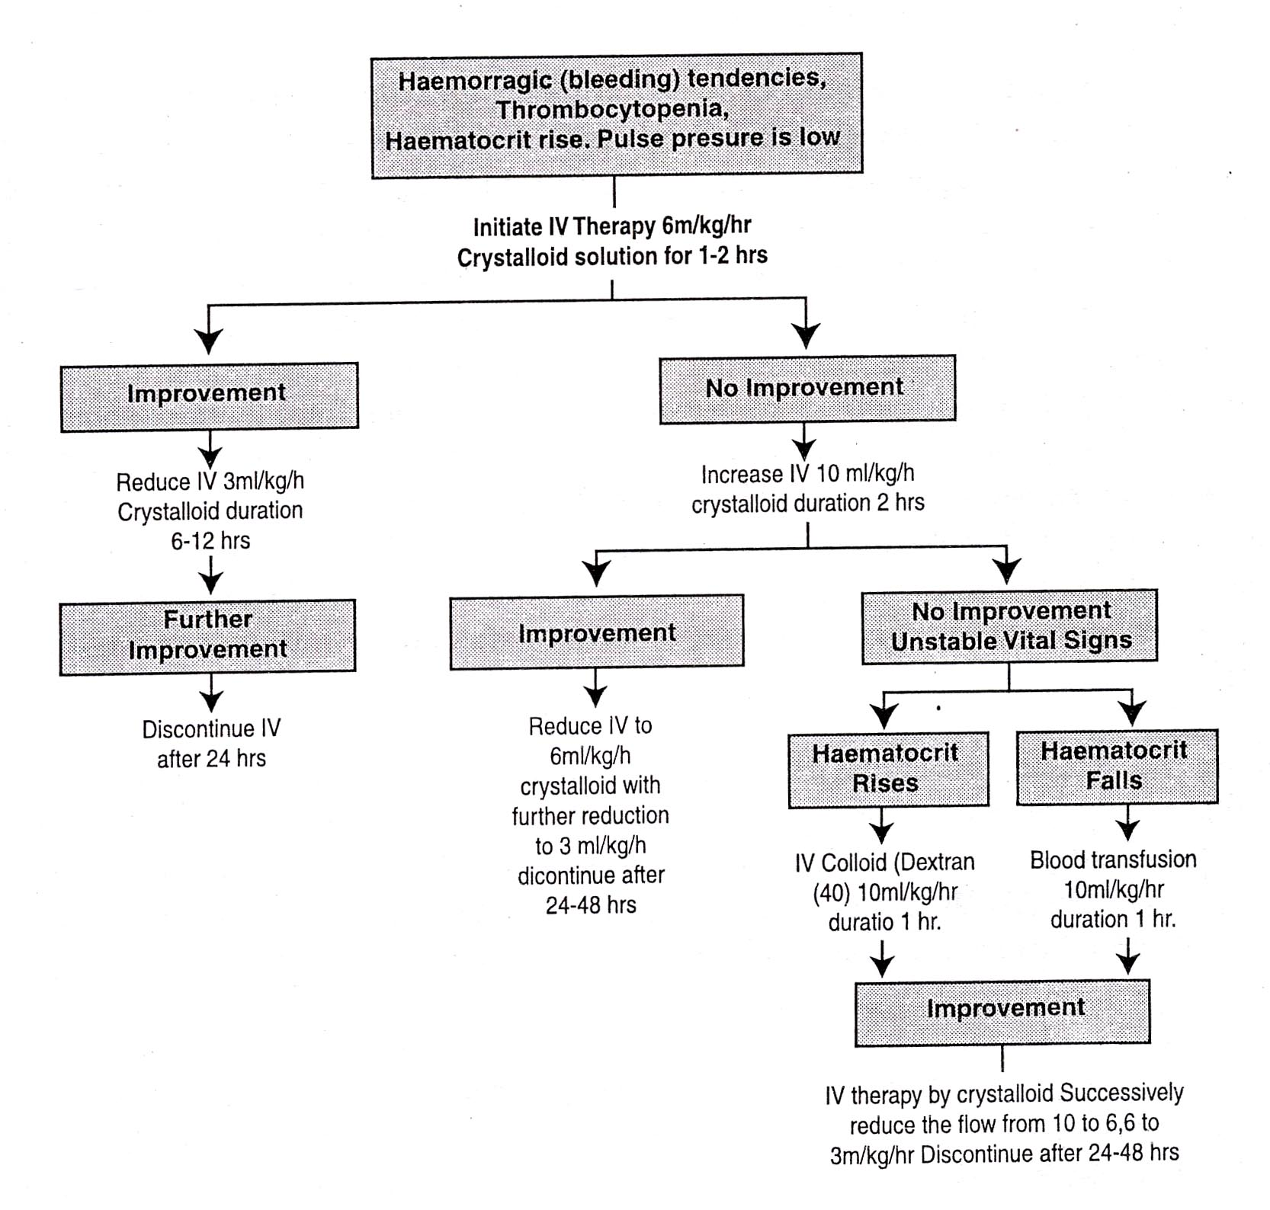
DHF Grades I & II: Volume Replacement Chart.

Slide 31
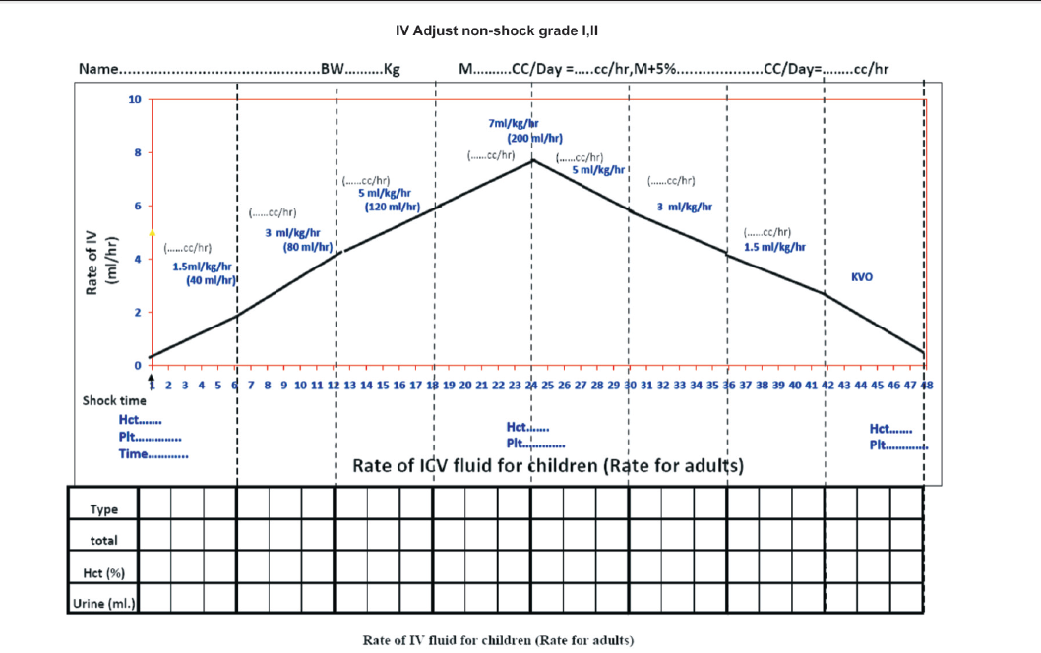

Slide 32
Rate of IV replacement
The rate of IV replacement should be adjusted according to the rate of plasma loss, guided by the clinical condition, vital signs, urine output and haematocrit levels.

Slide 33
Indication of Platelet Transfusion
Platelet transfusion is not recommended for thrombocytopenia (no prophylaxis platelet transfusion).
It may be considered in adults with underlying hypertension and very severe thrombocytopenia (less than 10 000 cell/mm3).

Slide 34
Management of patients with warning signs
It is important to verify if the warning signs are due to dengue shock syndrome or other causes such as acute gastroenteritis, vasovagal reflex, hypoglycemia, etc.
The presence of thrombocytopenia with evidence of plasma leakage such as rising haemotocrit and pleural effusion differentiates DHF/ DSS from other causes.
Blood glucose level and other laboratory tests may be indicated to find the causes.
For other causes, IV fluids and supportive and symptomatic treatment should be given while these patients are under observation in hospital.
They can be sent home within 8 to 24 hours if they show rapid recovery and are not in the critical period (i.e. when their platelet count is >100 000 cells/mm3).

Slide 35
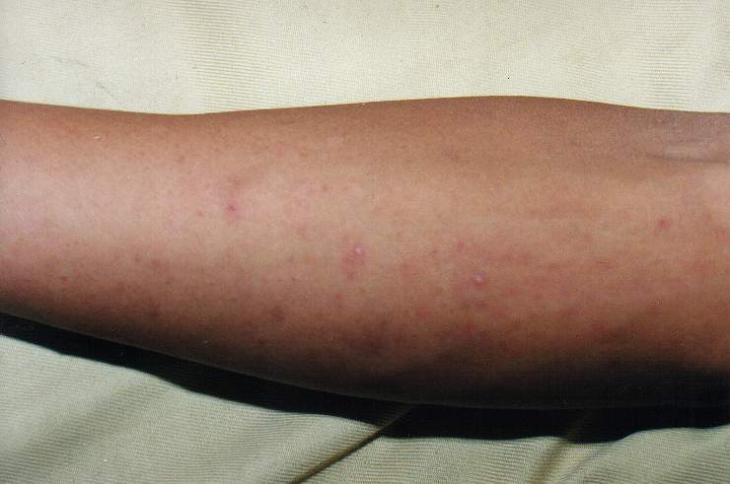
MANAGEMENT OF DHF Grade I & II
Patients should be obsereved for atleast 3 days after fall in temperature for
PURPURA ON THE SKIN

Slide 36
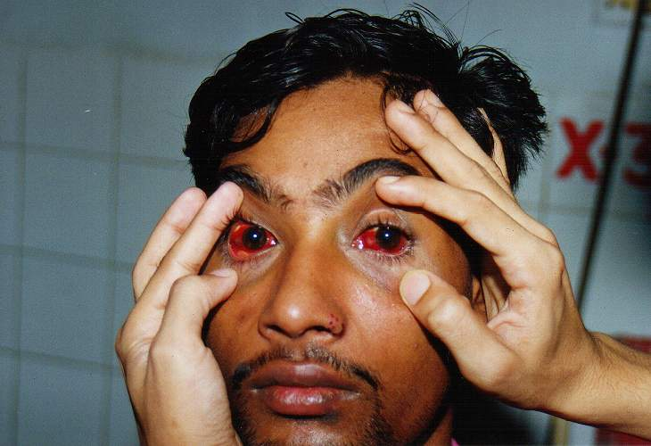
MANAGEMENT OF DHF Grade I & II
SUB CONJUNCTIAL HAEMORRHAGE

Slide 37
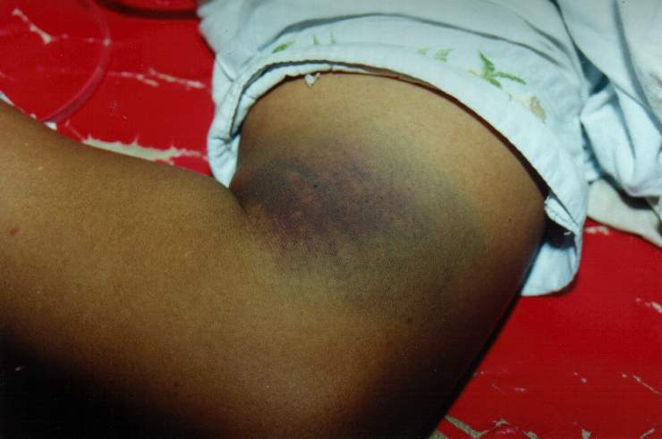
MANAGEMENT OF DHF Grade I & II
BLUE SPOTS ON THE SKIN

Slide 38
Management of shock: DHF Grade 3
DSS is hypovolemic shock caused by plasma leakage and characterized by increased systemic vascular resistance, manifested by narrowed pulse pressure (systolic pressure is maintained with increased diastolic pressure, e.g. 100/90 mmHg).
When hypotension is present, one should suspect that severe bleeding, and often concealed gastrointestinal bleeding, may have occurred in addition to the plasma leakage.

Slide 39
Management of shock: DHF Grade 3
It should be noted that the fluid resuscitation of DSS is different from other types of shock such as septic shock.
Most cases of DSS will respond to 10 ml/kg in children or 300–500 ml in adults over one hour or by bolus, if necessary.
However, before reducing the rate of IV replacement, the clinical condition, vital signs, urine output and haematocrit levels should be checked to ensure clinical improvement.

Slide 40
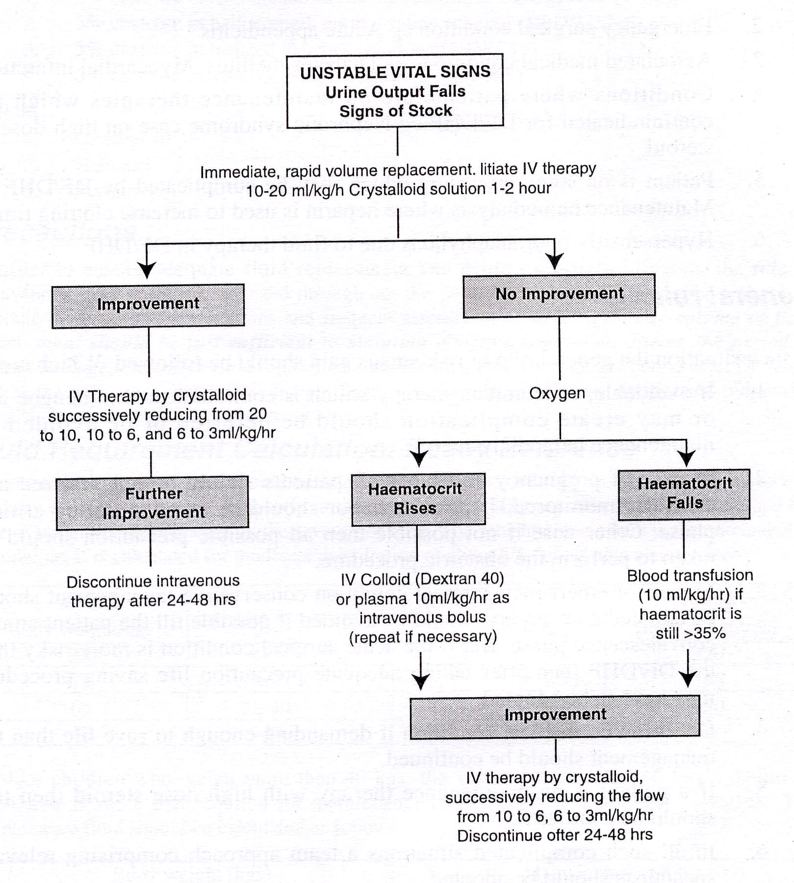
DHF Grades III & IV: Volume Replacement Chart.

Slide 41
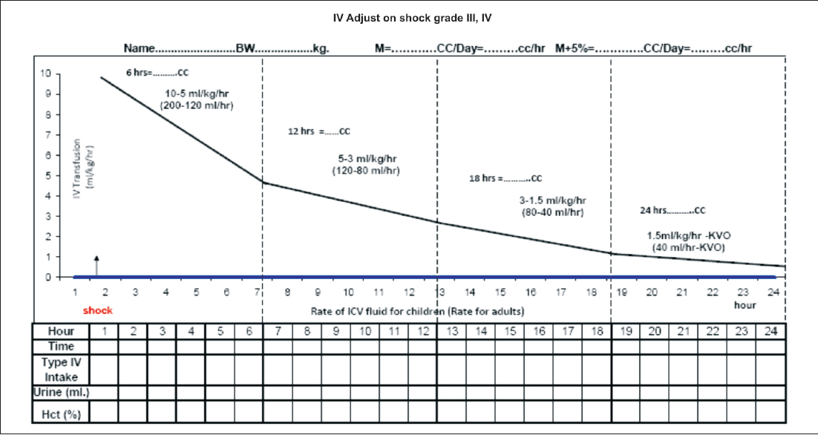
Rate of infusion in DSS case

Slide 42
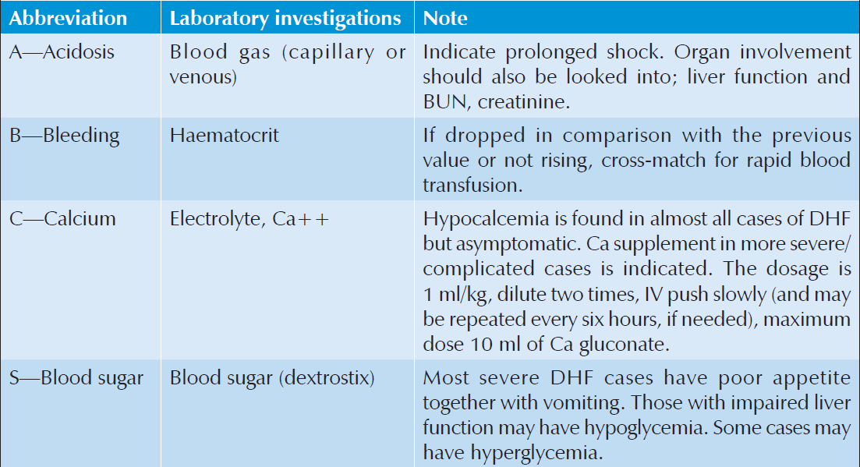
Laboratory investigations (ABCS) for patients who present with profound shock

Slide 43
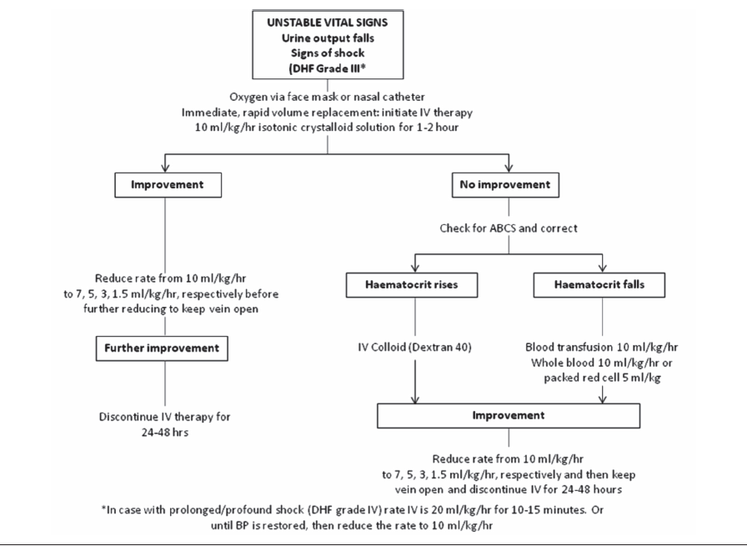
Volume replacement flow chart for patients with DSS

Slide 44
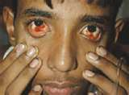
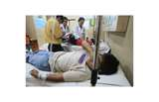

Slide 45
Management of prolonged/profound shock: DHF Grade 4
The initial fluid resuscitation in Grade 4 DHF is more vigorous.
Even mild hypotension should be treated aggressively.
10 ml/kg of bolus fluid should be given as fast as possible, ideally within 10 to 15 minutes.
When the blood pressure is restored, further intravenous fluid may be given as in Grade 3.

Slide 46
Management of prolonged/profound shock: DHF Grade 4
If shock is not reversible after the first 10 ml/ kg, a repeat bolus of 10 ml/kg and laboratory results should be pursued and corrected as soon as possible.
Urgent blood transfusion should be considered as the next step (after reviewing the preresuscitation HCT) and followed up by closer monitoring, e.g. continuous bladder catheterization, central venous catheterization or arterial lines.

Slide 47
Management of prolonged/profound shock: DHF Grade 4
It should be noted that restoring the blood pressure is critical for survival and if this cannot be achieved quickly then the prognosis is extremely grave.
Inotropes may be used to support the blood pressure, if volume replacement has been considered to be adequate such as in high central venous pressure (CVP), or cardiomegaly, or in documented poor cardiac contractility.

Slide 48
Management of prolonged/profound shock: DHF Grade 4
If blood pressure is restored after fluid resuscitation with or without blood transfusion, and organ impairment is present, the patient has to be managed appropriately with special supportive treatment.
Examples of organ support are peritoneal dialysis, continuous renal replacement therapy
and mechanical ventilation.
If intravenous access cannot be obtained urgently, try oral electrolyte solution if the patient is conscious or the intraosseous route if otherwise. The intraosseous access is life-saving and should be attempted after 2–5 minutes or after two failed attempts at peripheral venous access or after the oral route fails.

Slide 49
Management of severe haemorrhage
If the source of bleeding is identified, attempts should be made to stop the bleeding if possible.
Urgent blood transfusion is life-saving and should not be delayed till the HCT drops to low levels.
If blood loss can be quantified, this should be replaced. However, if this cannot be quantified, aliquots of 10 ml/kg of fresh whole blood or 5 ml/kg of freshly packed red cells should be transfused and response evaluated. The patient may require one or more aliquot.

Slide 50
Management of severe haemorrhage
In gastrointestinal bleeding, H-2 antagonists and proton pump inhibitors have been used, but there has been no proper study to show its efficacy.
There is no evidence to support the use of blood components such as platelet concentrates, fresh frozen plasma or cryoprecipitate. Its use could contribute to fluid overload.
Recombinant Factor VII might be helpful in some patients without organ failure, but it is very expensive and generally not available.

Slide 51
Management of high-risk patients (In Special Situations)
Obese patients have less respiratory reserves and care should be taken to avoid excessive intravenous fluid infusions.
Infants also have less respiratory reserves and are more susceptible to liver impairment and electrolyte imbalance. Infants should, therefore, be evaluated more frequently for oral fluid intake and urine output.
Intravenous insulin is usually required to control the blood sugar levels in dengue patients with diabetes mellitus. Non-glucose containing crystalloids should be used.

Slide 52
Management of high-risk patients
Pregnant women with dengue should be admitted early to intensely monitor disease progress. Joint care among obstetrics, medicine and paediatrics specialities is essential. Families may have to be counselled in some severe situations. Amount and rate of IV fluid for pregnant women should be similar to those for non-pregnant woman using pre-pregnant weight for calculation.
Patients with hypertension may be on anti-hypertensive therapy that masks the cardiovascular response in shock. A blood pressure that is perceived to be normal may in fact be low for these patients.

Slide 53
Management of high-risk patients
Anti-coagulant therapy may have to be stopped temporarily during the critical period.
Haemolytic diseases and haemoglobinopathies: These patients are at risk of haemolysis and will require blood transfusion. Caution should accompany hyperhydration and alkalinization therapy, which can cause fluid overload and hypocalcemia.

Slide 54
Management of high-risk patients
Congenital and ischaemic heart diseases: Fluid therapy should be more cautious as they may have less cardiac reserves.
Patients on steroid therapy, continued steroid treatment is recommended but the route may be changed.

Slide 55
Management of convalescence
Convalescence can be recognized by the improvement in clinical parameters, appetite and general well-being.
Haemodynamic state such as good peripheral perfusion and stable vital signs should be observed.
Decrease of HCT to baseline or below and dieresis are usually observed.
Intravenous fluid should be discontinued.

Slide 56
Management of convalescence
In those patients with massive effusion and ascites, hypervolemia may occur and diuretic therapy may be necessary to prevent pulmonary oedema.
Hypokalemia may be present due to stress and diuresis and should be corrected with potassium-rich fruits or supplements.
Bradycardia is commonly found and requires intense monitoring for possible rare complications such as heart block or ventricular premature contraction (VPC).
Convalescence rash is found in 20%–30% of patients.

Slide 57
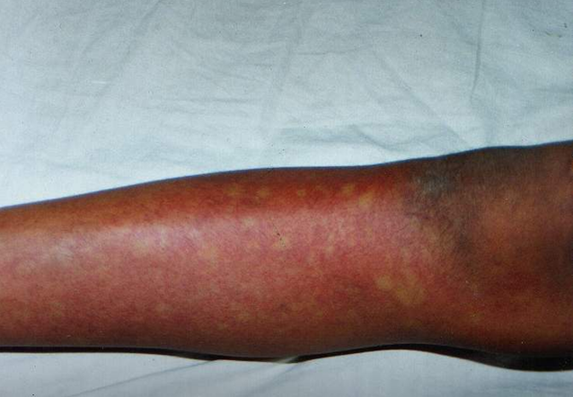
CONVALESCENT CONFLUENT PETECHIAE RASH

Slide 59
Signs of recovery
Stable pulse, blood pressure and breathing rate.
Normal temperature.
No evidence of external or internal bleeding.
Return of appetite.
No vomiting, no abdominal pain.
Good urinary output.
Stable haematocrit at baseline level.
Convalescent confluent petechiae rash or itching, especially on the extremities.

Slide 60
Criteria for discharging patients
Absence of fever for at least 24 hours without the use of anti-fever therapy.
Return of appetite.
Visible clinical improvement.
Satisfactory urine output.
A minimum of 2–3 days have elapsed after recovery from shock.
No respiratory distress from pleural effusion and no ascites.
Platelet count of more than 50 000/mm3. If not, patients can be recommended to avoid traumatic activities for at least 1–2 weeks for platelet count to become normal. In most uncomplicated cases, platelet rises to normal within 3–5 days.

Slide 61
Management of complications
Detection of fluid overload in patients
Management of fluid overload
Management of encephalopathy

Slide 62
Referral to Tertiary Care Hospital
Infants <1 year old.
Obese patients.
Pregnant women.
Profound/prolonged shock.
Significant bleeding.
Repeated shock 2–3 times during treatment.
Patients who seem not to respond to conventional fluid therapy.
Patients who continue to have rising haematocrit and no colloidal solution is available.
Patients with known underlying diseases such as Diabetes mellitus (DM) , hypertension, heart disease or haemolytic disease.
Patients with signs and symptoms of fluid overload.
Patient with isolated/multiple organ involvement.
Patients with neurological manifestations such as change of consciousness, semi-coma, coma, convulsion, etc.

Slide 63
Take Home Message

Slide 64
Dos or Don’ts:
1. Do not give aspirin or any NSAIDs for the treatment
of any fever.
2. Cases of DHF should be observe hourly.
3. Avoid giving I/V therapy before there is evidence
of hemorrhage or bleeding. ORT with ORS or its
equivalent is recommended for patients with
moderate dehydration caused by vomiting & high
temperature.
4. Avoid giving blood transfusion unless indicated,
reduction in hematocrit or severe bleeding.

Slide 65
Dos or Don’ts:
4. Avoid giving steroid as these will complicate the
situation and there is no sound evidenced based
indication.
5. Food should be given according to appetite. But
fresh fruit juice should be given frequently. Avoid
commercially available juices due to preservatives.
6. Don’t use antibiotics as these don’t help.
7. Don’t change the speed of fluid rapidly.
8. In case of infant & children if there is febrile
convulsion and or history of so appropriate
standard measures should be taken.

Slide 66
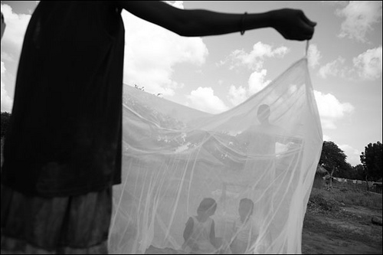
Thank you

